Slide 1
COMS6998 Topics in Human Language Technology (HLT)
Kenneth Church
Kenneth.Ward.Church@gmail.com
http://www.columbia.edu/~kc3109/

Slide 2
Too many papers are boring
Survey papers
(and most conference papers)
tend to be boring
It is ok to be wrong,
but please don't be boring
Main assignment:
Write a survey paper
Due at the end of the term
The survey paper should discuss 1+ seminal papers,
and the impact on subsequent literature

Slide 3
Weekly Assignments (To encourage everyone to keep up with the reading)
Imagine you are writing a survey paper on the paper(s) assigned for that week and their impact on the subsequent literature
For the imaginary survey paper, I want to see:
an abstract of no more than 200 words
Outlining the argument in the imaginary paper
Citation counts for the assigned paper(s) (from Google Scholar)
A partial bibliography of 10-30 references of papers that would be appropriate to discuss in the imaginary survey
1-3 tweets (< 140 chars) pitching the imaginary survey
The imaginary tweets should identify an audience that might not read the imaginary survey (if it existed) without more motivation to do so
A review of the imaginary survey paper (using a standard review form), from the perspective of an imaginary reviewer

Slide 4
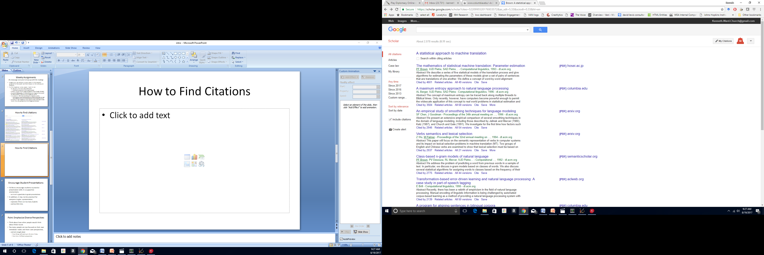
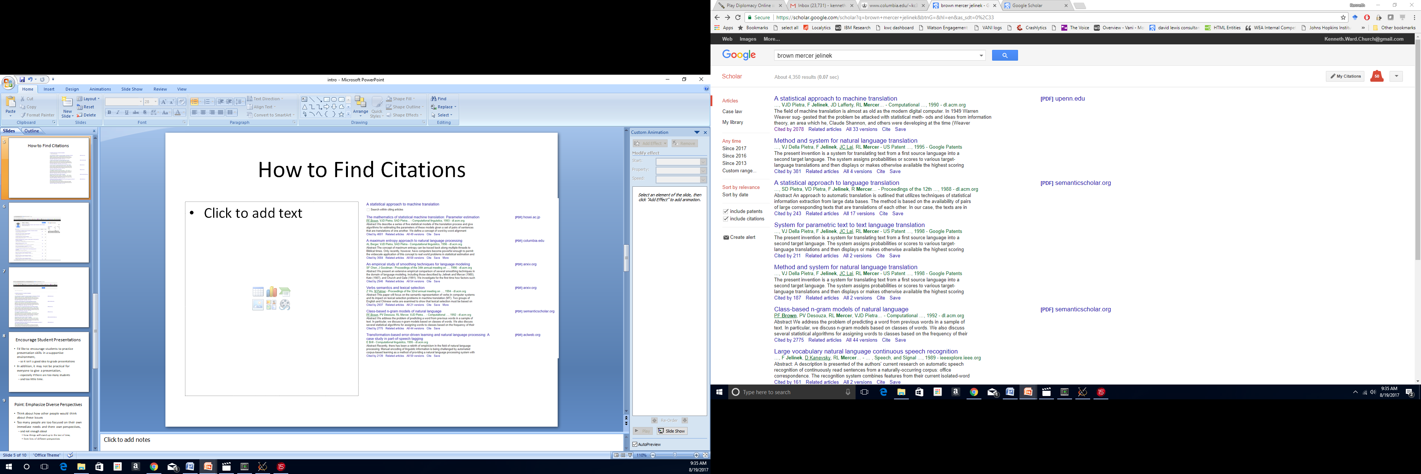
How to Find Citations with Google Scholar

Slide 5
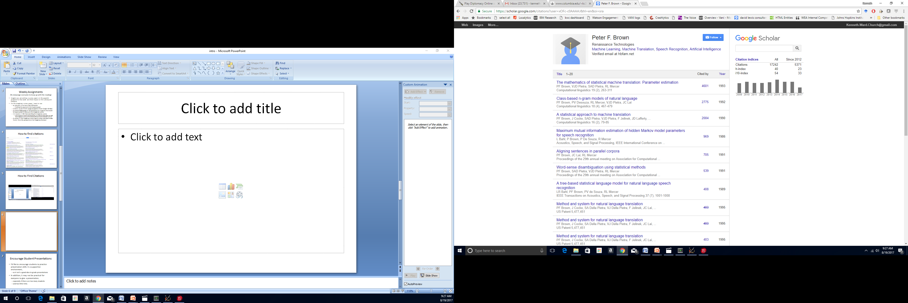
Google Scholar Citations

Slide 6
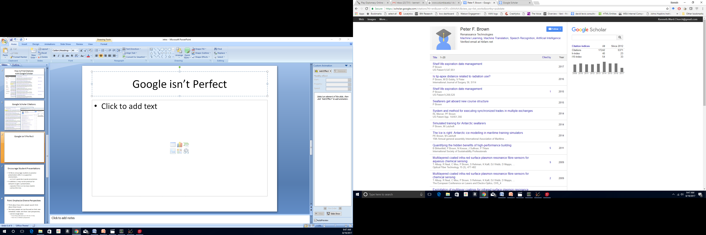
Google isn’t Perfect
h-index ≥ 40 → http://web.cs.ucla.edu/~palsberg/h-number.html

Slide 7
Encourage Student Presentations
I'd like to encourage students to practice presentation skills in a supportive environment,
so it isn't a good idea to grade presentations
In addition, it may not be practical for everyone to give a presentation,
especially if there are too many students
and too little time.

Slide 8
Point: Emphasize Diverse Perspectives
Think about how other people would think about these issues
Too many people are too focused on their own immediate needs and there own perspectives,
and not enough about
how things will stand up to the test of time,
from lots of different perspectives

Slide 9
Why Survey Papers?
My first presentation was on my own research
Many rock bands start out doing covers
before they write their own music
So too, I believe students should start out presenting covers of seminal papers
before presenting their own research

Slide 10
First Assignment (Due WED midnight) http://www.columbia.edu/~kc3109/
Vote here on papers/videos/topics
you would like to cover in the course
as well as papers you would like to present
NOTE: there are TWO tabs
The first assignment involves skimming as much of this work as possible
so you can cast reasonably informed votes.

Slide 11
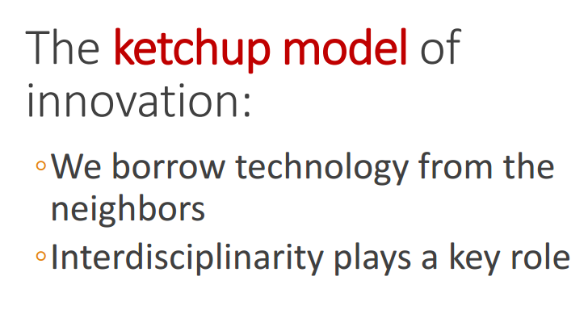
Topic 1: Ketchup https://www.superlectures.com/interspeech2016/
Jurafsky uses history of ketchup (& ice cream elsewhere)
to shed light on currently popular methods in speech and language
He traces etymology of “ketchup” from an Asian fish sauce
Advances in (sailing) technology made it possible to replace anchovies with less expensive tomatoes and sugar from the west
The ice cream story combines fruit syrups (Sharbat) from Persia
with gun powder from China and advances in refrigeration technology
Big Tent

Slide 12
The Speech Invasion
At speech meetings (Interspeech-2016, as opposed to NAACL-2009),
Jurafsky credits speech researchers for transferring currently popular techniques from speech to language
Some of these people were probably also involved in transferring similar methods from information theory into speech (and perhaps hedge funds)

Slide 13
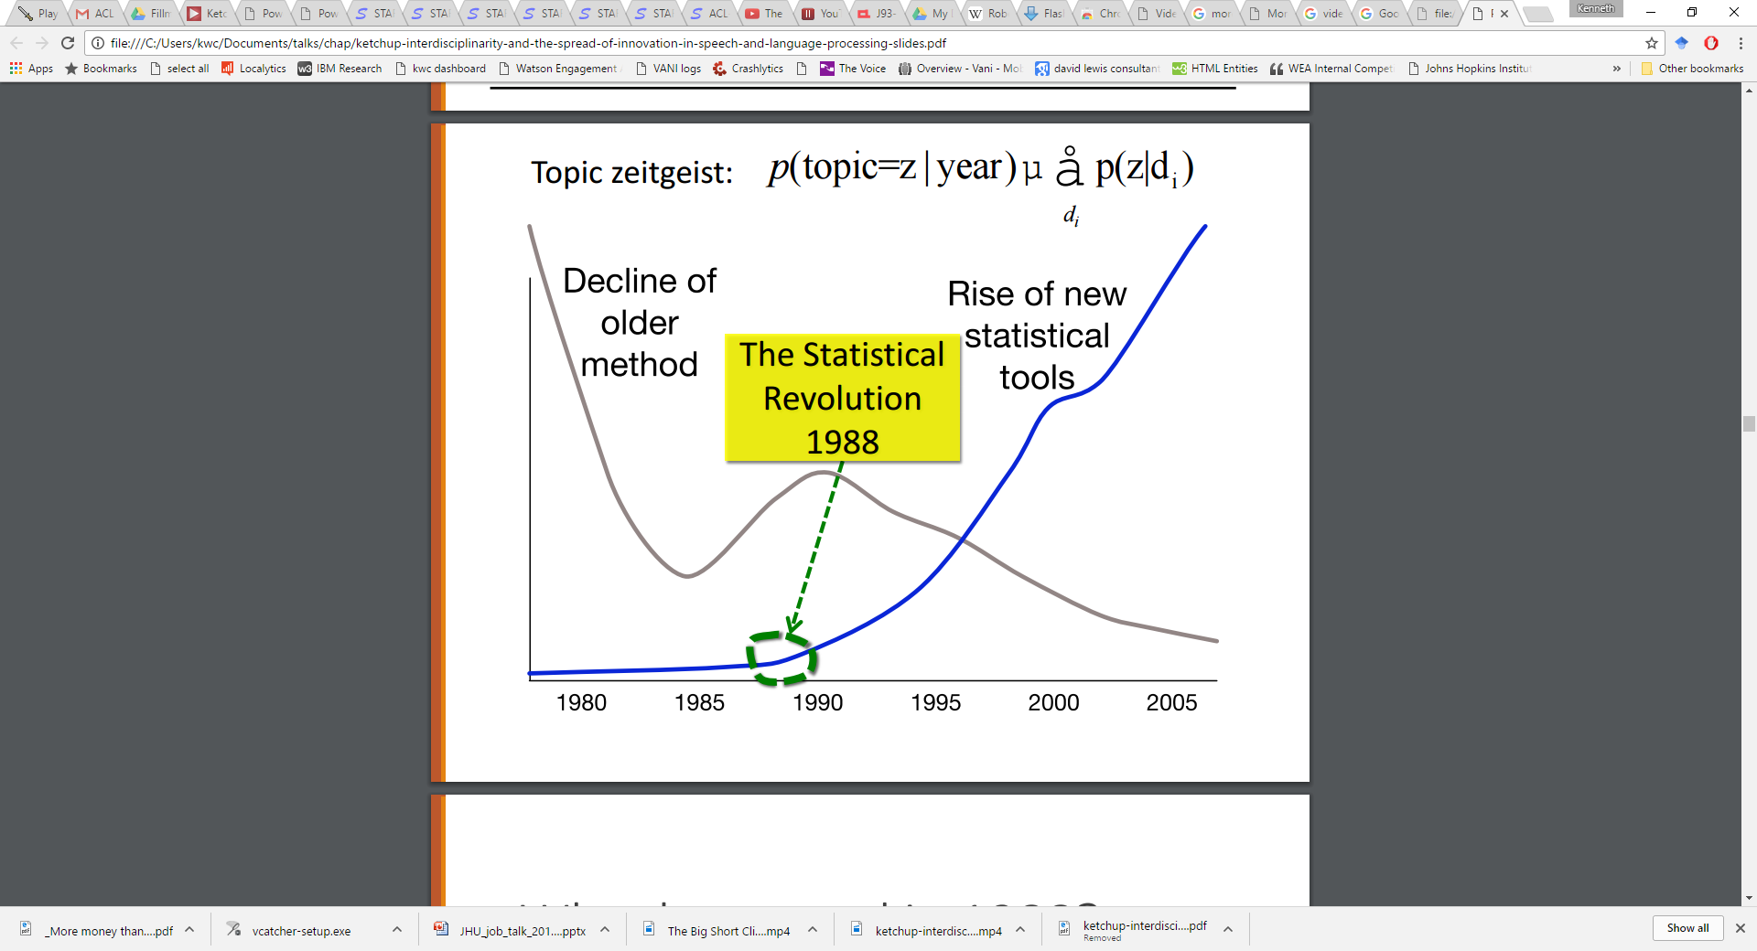
What happened in 1988?

Slide 14
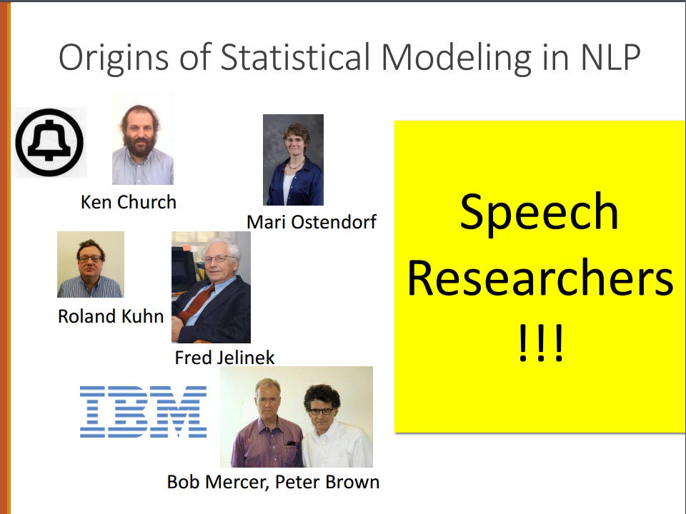
What happened in1988?

Slide 15
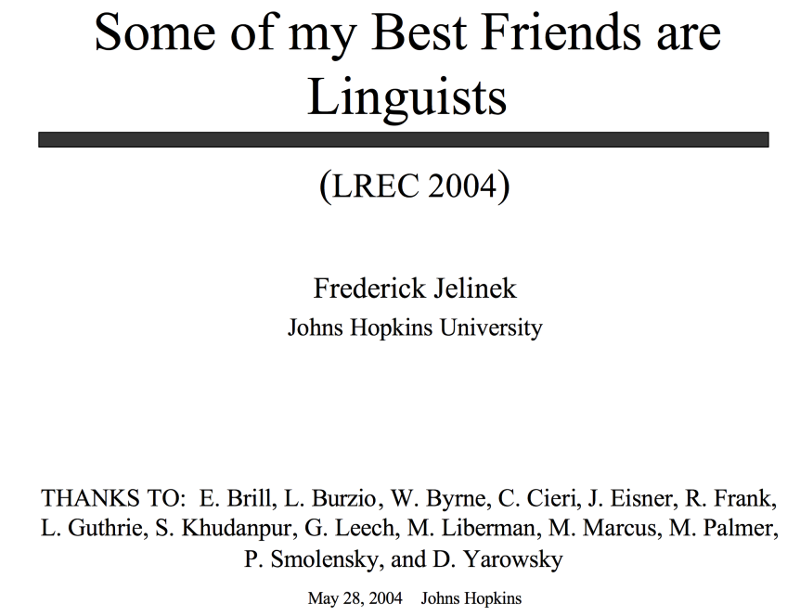
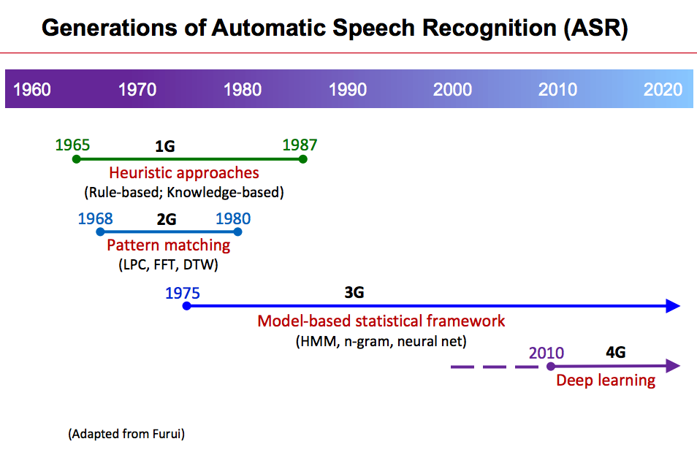
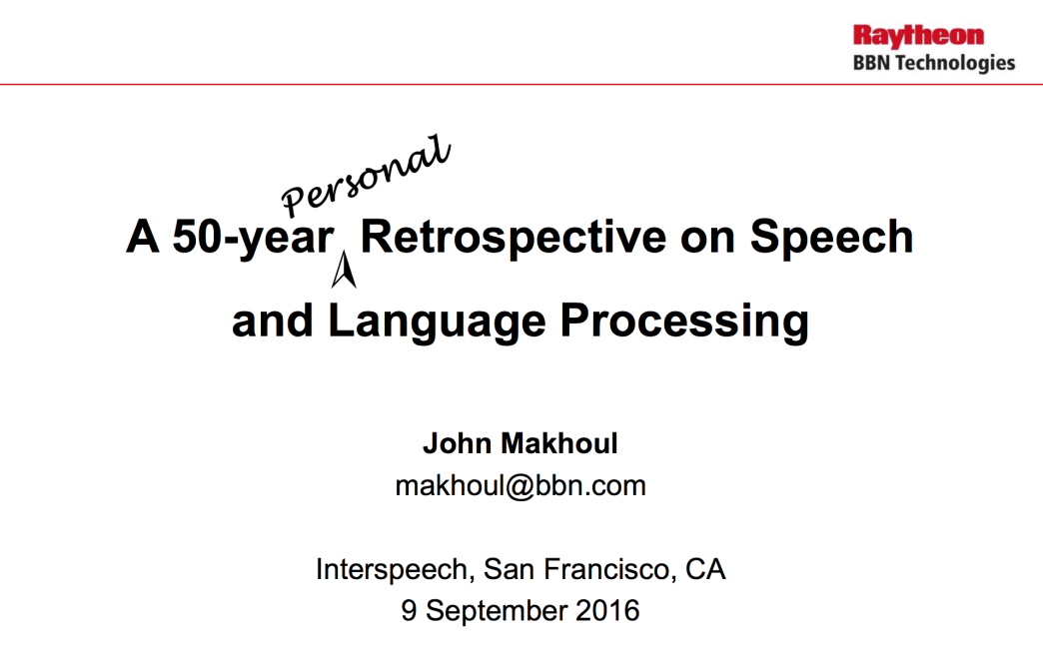
Jurafsky’s story is nice & simple,
But history is “complicated”
IMHO,
speech did onto language,
what was done onto them
https://www.superlectures.com/interspeech2016/
What happened in 1975?
The same thing that happened to language in 1988
(and to hedge funds in 1990s)?

Slide 16
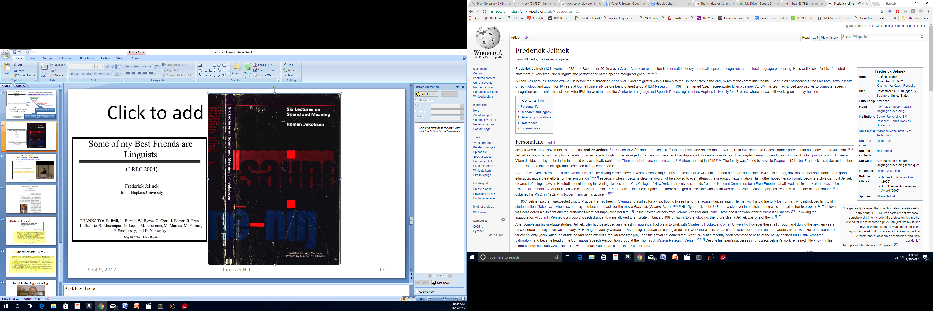
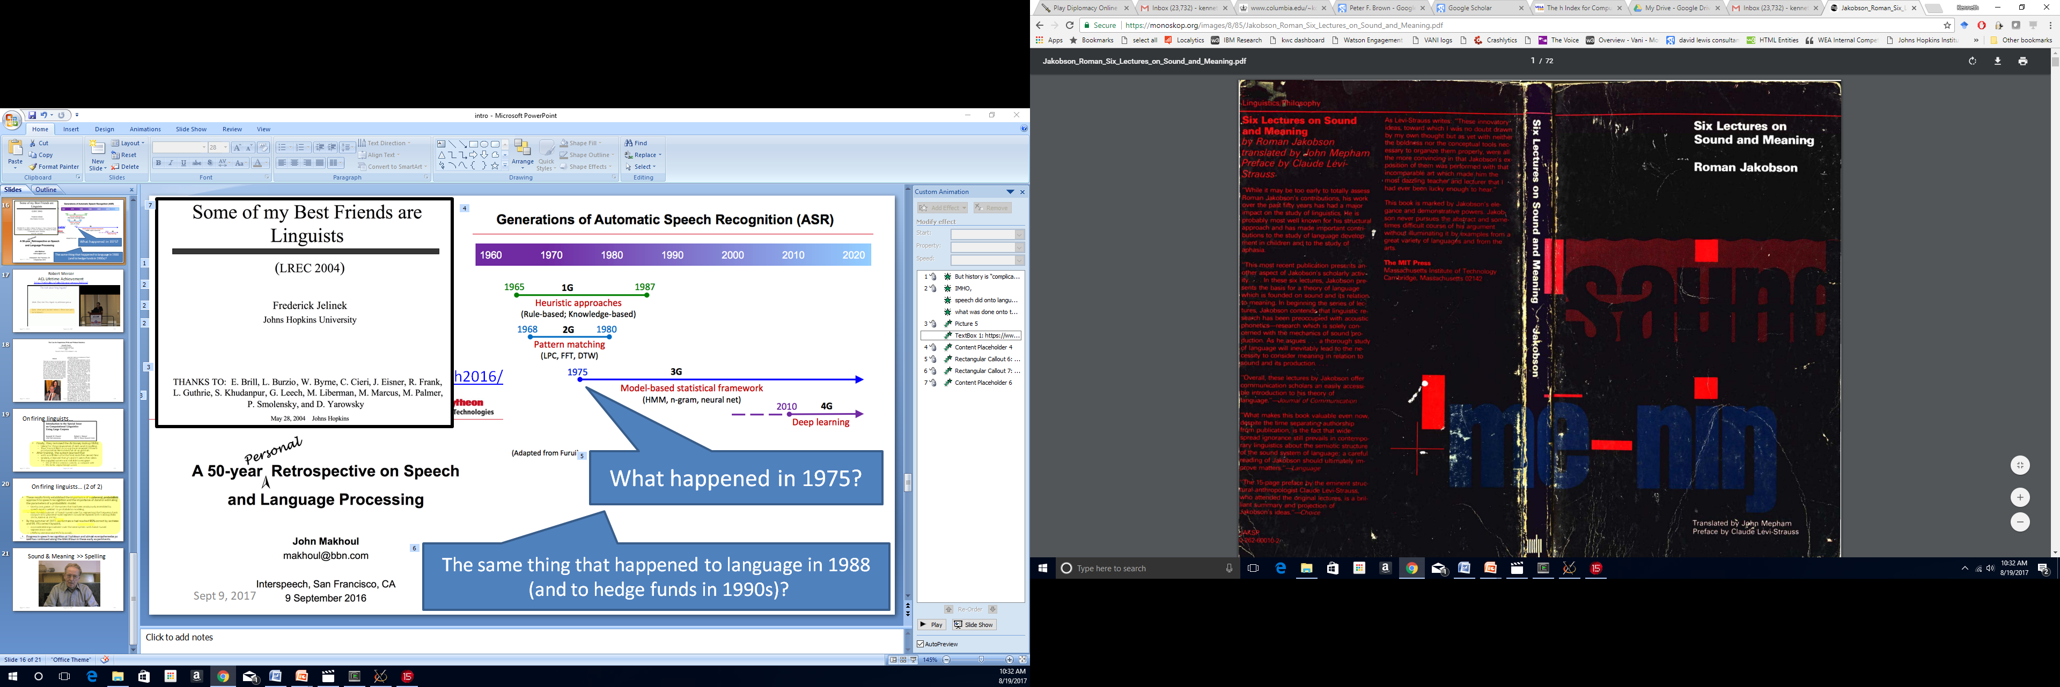

Slide 17
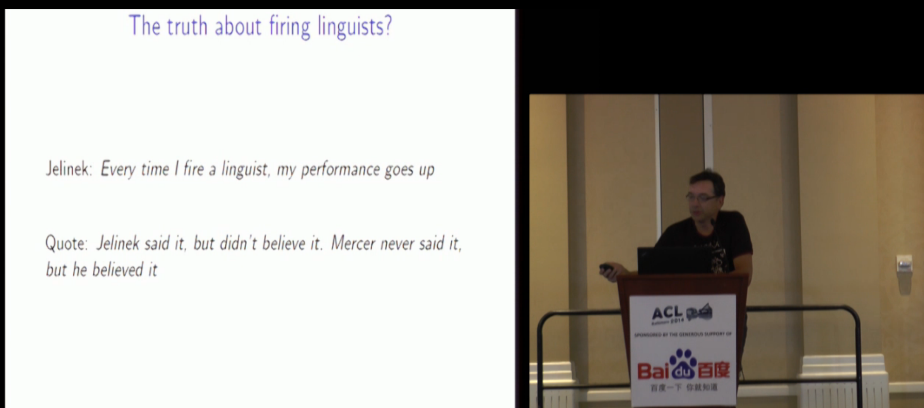
Robert Mercer ACL Lifetime Achievement http://techtalks.tv/talks/closing-session/60532/

Slide 18
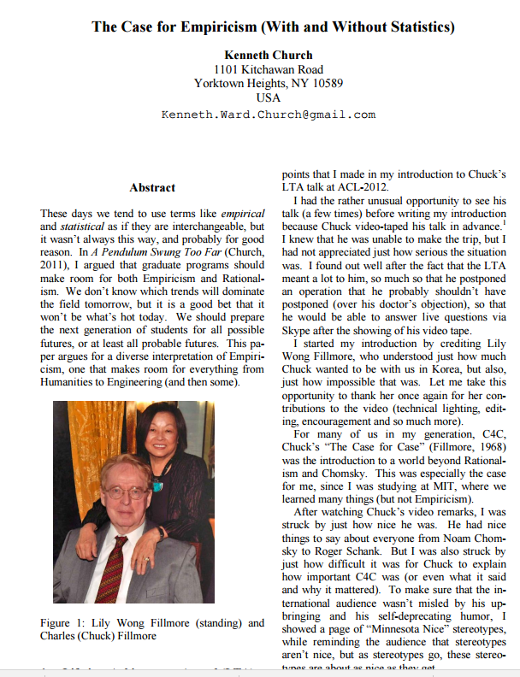

Slide 19
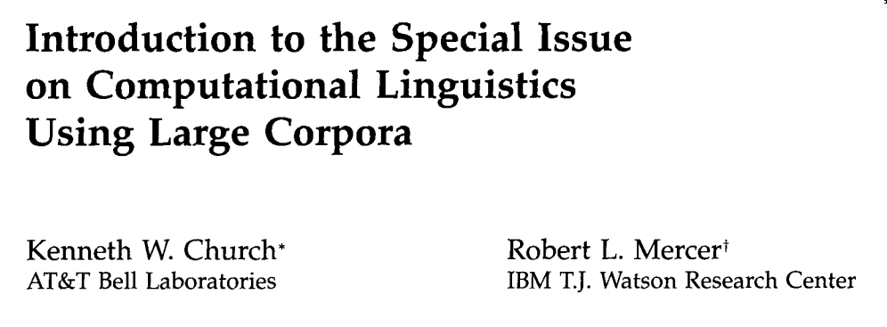
On firing linguists…
Finally, they removed the dictionary lookup HMM,
taking for the pronunciation of each word its spelling.
Thus, a word like t-h-r-o-u-g-h was assumed to have a pronunciation like tuh huh ruh oh uu guh huh.
After training, the system learned that
with words like l-a-t-e the front end often missed the e.
Similarly, it learned that g's and h's were often silent.
This crippled system was still able to recognize
43% of 100 test sentences correctly as compared with
35% for the original Raleigh system.

Slide 20
On firing linguists… (2 of 2)
These results firmly established the importance of a coherent, probabilistic approach to speech recognition and the importance of data for estimating the parameters of a probabilistic model.
One by one, pieces of the system that had been assiduously assembled by speech experts yielded to probabilistic modeling.
Even the elaborate set of hand-tuned rules for segmenting the frequency bank outputs into phoneme-sized segments would be replaced with training (Bakis 1976; Bahl et al. 1978).
By the summer of 1977, performance had reached 95% correct by sentence and 99.4% correct by word,
a considerable improvement over the same system with hand-tuned segmentation rules
(73% by sentence and 95% by word).
Progress in speech recognition at Yorktown and almost everywhere else as well has continued along the lines drawn in these early experiments.
As computers increased in power, ever greater tracts of the heuristic wasteland opened up for colonization by probabilistic models.
As greater quantities of recorded data became available,
these areas were tamed by automatic training techniques.

Slide 21
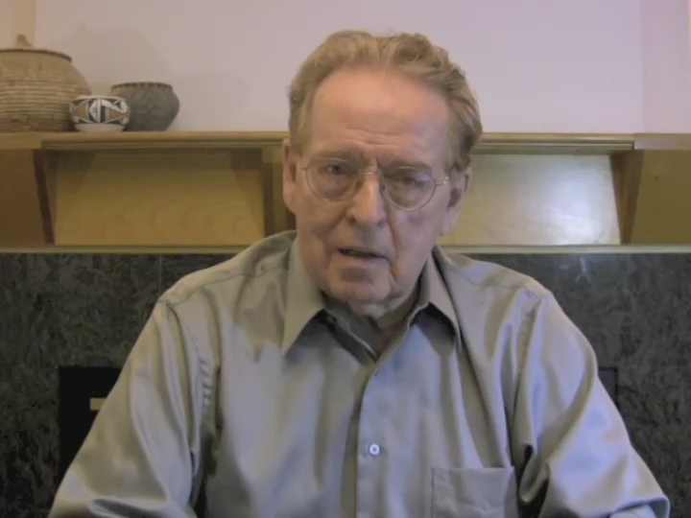
Sound & Meaning >> Spelling

Slide 22
Topic 2: The Speech Invasion
The Mathematics of Statistical Machine Translation: Parameter Estimation
The foundation of most MT work today
Peter Brown’s daughter asked him if he knew that machines can translate…
A stochastic parts program and noun phrase parser for unrestricted text
As a grad student, I was told that everything we could do in NLP had already been done (so I should work on things we couldn’t do like pragmatics)
So, it wasn’t easy to present a paper on something that had been “solved”
An Introduction to Hidden Markov Models
The classic reference is often the most accessible (not first, last or best)
Shannon's Theory of Communication
Amazingly accessible
Shannon's Estimate of the Entropy of English
Even more accessible

Slide 23
Topic 3: Case for Case
Speech vs. Language and the Case for Case
It is interesting to contrast Fillmore's views on spelling here
with Mercer's in their ACL Lifetime Achievement here
Fillmore is a linguist who believes that sound and meaning are better sources of evidence than spelling,
whereas Mercer believes every time I fire a linguist, my performance goes up (as discussed in the introduction to video, Jelinek said it, but Mercer believes it)

Slide 24
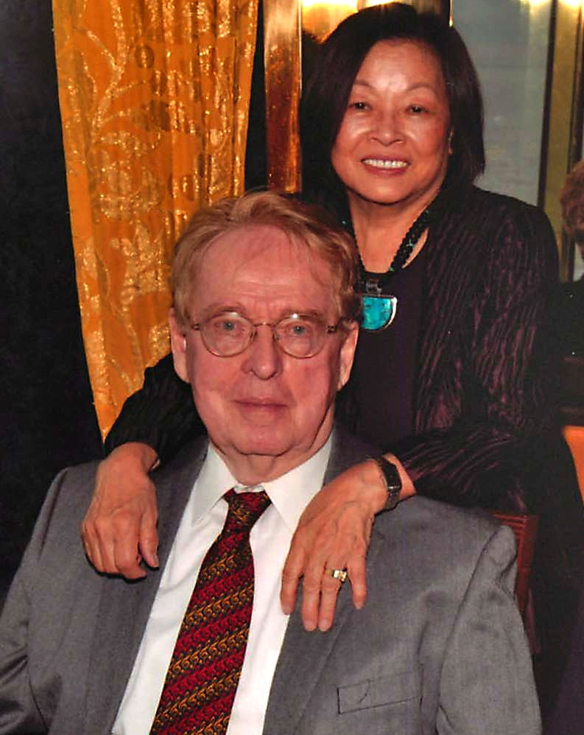
LTA-2012: Charles J Fillmore
Highlights
Case for Case
6k citations in Google Scholar
Framenet
2 papers with 1k citations each
“Minnesota Nice”
Nice things to say about everyone: Chomsky/Schank
Self-deprecating humor
(but don’t you believe it)

Slide 25
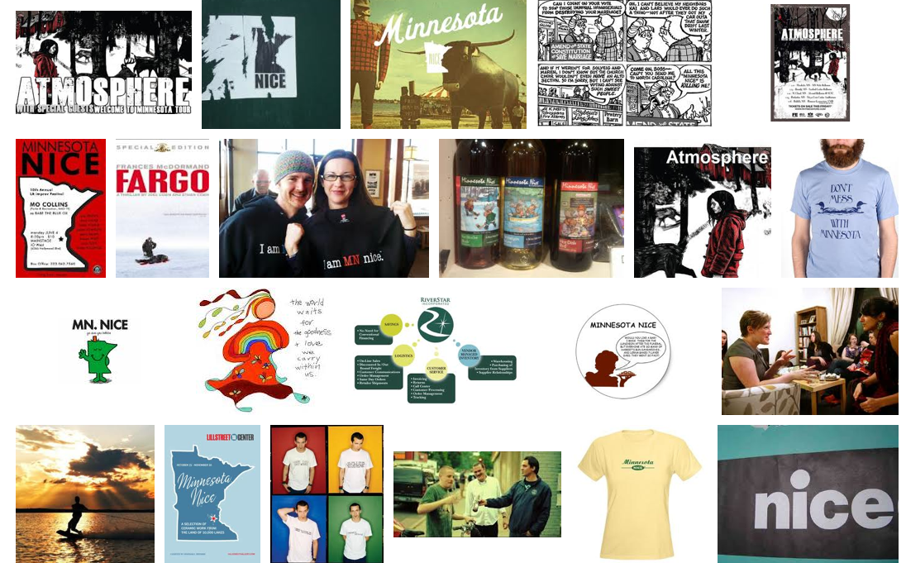
Minnesota Nice

Slide 26
Case for Case (C4C): Practical Apps
Information Extraction (MUC)
Semantic Role Labeling
Key Question: Who did what to whom?
Not: What is the NP and the VP of S?

Slide 27
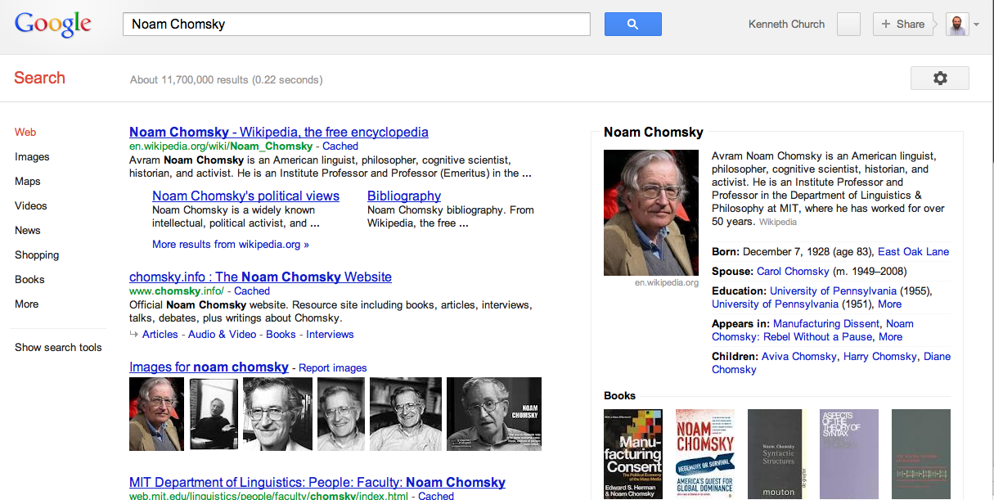
Commercial Information Extraction

Slide 28
Do Read “Case for Case”
Great arg but also
Demonstrates strong command of
Classic literature as well as
Linguistic facts
Our field:
Too “silo”-ed
Too few citations to
Classic literature, other fields and other types of facts
We could use more “Minnesota Nice”

Slide 29
Historical Motivation: A Case for Case From Morphology → MUC
Context Free Grammar is attractive for
Langs with more word order and less morphology (English)
But Case Grammar is attractive for
Langs with more morphology and less word order
Examples: Latin, Greek & Japanese
Latin (over-simplified):
Subject: Nominative case
Object: Accusative case
Indirect Object: Dative case
Other args: Ablative case

Slide 30
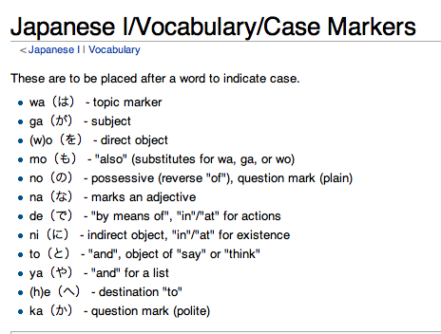
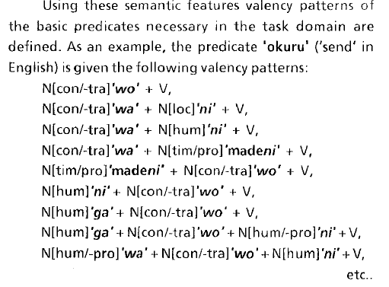
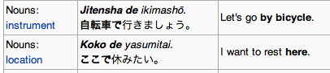

Slide 31
Case Grammar → Frames / Lexicography Valency → Scripts (Roger Schank) / Lexicography (Sue Atkins)
Valency: Predicates have args (optional & required)
Example: “give” requires 3 args:
Agent (A), Object (O), and Beneficiary (B)
Jones (A) gave money (O) to the school (B)
Latin Morphology:
Nominative, Accusative & Dative

Slide 32
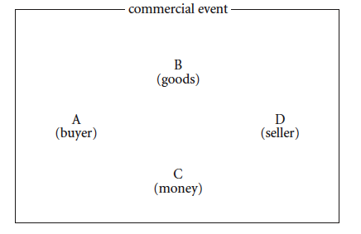
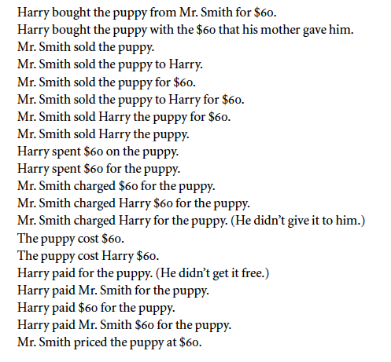
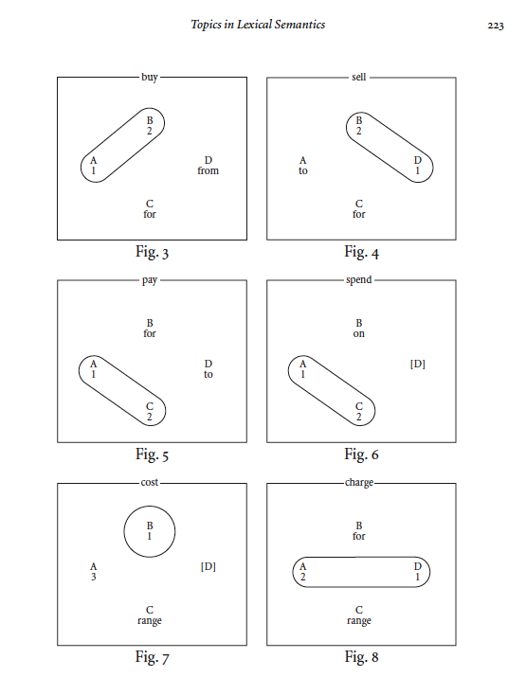

Slide 33
Case Grammar → Frames / Lexicography Valency → Scripts (Roger Schank) / Lexicography (Sue Atkins)
Valency: Predicates have args (optional & required)
Example: “give” requires 3 arguments:
Agent (A), Object (O), and Beneficiary (B)
Jones (A) gave money (O) to the school (B)
Latin Morphology: Nominative, Accusative & Dative
Frames
Commercial Transaction Frame: Buy/Sell/Pay/Spend
Save <good thing> from <bad situation>
Risk <valued object> for <situation>|<purpose>|<beneficiary>|<motivation>
Collocations & Typical predicate argument relations:
Save whales from extinction (not vice versa)
Ready to risk everything for what he believes
Representation Challenges: What matters for practical apps/NLU?
Stats on POS? Word order? Frames (typical predicate-args/collocations)?

Slide 34
Challenge for Next Generation: General Linguistics → Computational Linguistics
Challenge:
Do corpus-based lexicography methods scale up?
Are they too manually intensive?
If so, could we use machine learning methods to speed up manual methods?
Just as statistical parsers learn phrase structure rules (S → NP VP)
Can we learn valency?
Collocations?
Typical predicate argument relations?
Corpus-size requirements: When can we expect to learn frames?
Many content words have freq in parts per million
1970s Corpora: 1 M words (Brown)
Large enough to make a list of content words
1990s: 100 M words (British National Corpora)
Large enough to see associations of common predicates with function words
“save” + “from”
Coming soon: (1M)^2 words (Google?)
Large enough to see associations of pairs of content words (collocations)
“give” + $$
“save” + “whale” and “save” + “extinction”
“risk” valued object for purpose

Slide 35
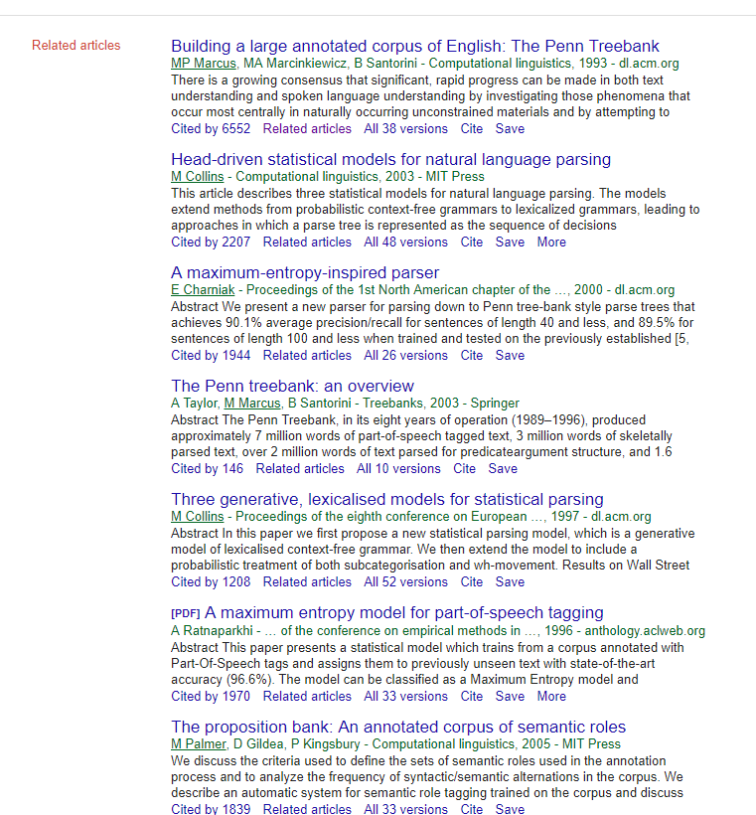
Topic 4: Parsing & Part of Speech Tagging
Parsing and part of speech tagging used to be one of the most important topics in computational linguistics
The Penn Treebank can be downloaded from here.
The Penn Treebank has a huge number of citations,
and many of the papers that cite this paper are also highly cited
Google scholar makes it easy to find these papers with links like this.

Slide 36
Topic 5: Whatever you measure, you get
When BLEU was first introduced,
it was impressive that the community could agree on a single evaluation metric,
and that that metric might be correlated with human judgments.
But when Och proposed optimizing the metric (here),
there was widespread concern that the optimization might find a way to game the metric,
resulting in a solution that would score high on the objective metric (BLEU),
but less well on subjective evaluations with humans.
Apparently, the metric stood up remarkably well to optimizing, though a number of alternatives have been proposed subsequently.

Slide 37
Topic 6: Machine Learning has a long history
Much of the early work is based on simple methods such as linear separators,
which can be used to distinguish relevant documents from irrelevant documents in
Information Retrieval,
positive sentiment from negative sentiment,
Hamilton's essays from Madison's, and so on.
Massive citations
Methods such as support vector machines and logistic regression tend to be cited even more than applications
Tools such as sklearn and libshorttext are also heavily cited,
as well as datasets such as this.

Slide 38
Topic 7: ALPAC & Whither Speech Recognition
There is a long tradition of questioning Machine Learning and Artificial Intelligence
Pierce chaired the ALPAC committee (which is credited for defunding research on Machine Translation)
He is also credited with defunding speech research with this letter to JASA: Whither Speech Recognition
It is convenient to dismiss Pierce's criticisms (because they are so inconvenient),
but Pierce is a force that should be taken seriously.
At Bell Labs,
He made contributions to speech including a coding standard, still used in WAV files today.
He was also involved in more significant projects such as the transistor and satellite telecommunications, and served as Vice President of Research.
Many of the arguments in the ALPAC report are still relevant today.
The full report is well worth reading, and can be found here.
It is ok for the next generation to reject positions held by previous generations,
but it isn't right to reject a position without reading it first.

Slide 39
Topic 8: WMD
A recent best seller, Weapons of Math Destruction (WMD),
continues the tradition of questioning Machine Learning
by pointing out that machines (opaque black boxes) are making lots of important decisions like:
Who gets into a good school
Who gets a loan
Who goes to jail
If machines are merely optimizing an objective function like $$
They will do so for better or for worse.
How can society enforce policies about fairness
If even those of us who built the machines
Have little understanding of what the optimizations are doing and why?

Slide 40
Topic 9: Minsky & Chomsky
Implications for currently popular methods in machine learning
Minsky and Chomsky were both at Harvard in the 1950s,
and they both started their careers by questioning the received wisdom at the time.
Perceptrons is a reaction to machine learning
and Syntactic Structures is a reaction to ngram language models.
While Minsky and Chomsky disagree on many/most issues,
their work had a chilling impact on various research directions for several decades.
Many of the methods that they objected to have since regained popularity,
and many of their objections are being ignored and forgotten
(perhaps for good reasons, and perhaps not)
On a more positive note, in addition to questioning the received wisdom at the time,
Syntactic Structures also inspired some great work in other fields (see how Knuth spent his honeymoon)
Work that appeals across multiple fields has a better chance of becoming highly cited
Legacy & Popular Press
Chomsky has published an amazing number of books
A number of videos are available on Youtube and Netflix.
Minsky is less organized/disciplined (and more eclectic).
This TED talk ends with Minsky objecting to neural nets, as he ran out of time.

Slide 41
Topic 10: . How does science (and engineering) progress?
Kuhn suggests the process has made significant progress over time
(unlike a pendulum swinging back and forth),
and that the progression is dramatic and far from incremental.
According to Wikipedia,
Kuhn argues that the evolution of scientific theory does not emerge from the straightforward accumulation of facts,
but rather from a set of changing intellectual circumstances and possibilities.
Kuhn dated the genesis of his book to 1947,
when he was a graduate student at Harvard University
and had been asked to teach a science class for humanities undergraduates
with a focus on historical case studies
Kuhn later commented that until then,
I'd never read an old document in science
Aristotle's Physics was astonishingly unlike
Isaac Newton's work in its concepts of matter and motion
Kuhn wrote
... as I was reading him,
Aristotle appeared not only ignorant of mechanics,
but a dreadfully bad physical scientist as well.
About motion, in particular, his writings seemed to me full of
egregious errors, both of logic and of observation.
This was in an apparent contradiction with the fact that Aristotle was a brilliant mind
While perusing Aristotle's Physics,
Kuhn formed the view that in order to properly appreciate Aristotle's reasoning,
one must be aware of the scientific conventions of the time.
Kuhn concluded that Aristotle's concepts were not “bad Newton,” just different.

Slide 42
Topic 11: Word2vec & Embeddings
Embeddings have become popular recently with word2vec.
A popular NIPS paper has suggested that word2vec is a factored version of
my work with Hanks on pointwise mutual information (PMI).
Scatter plots comparing word2vec with PMI show a modest correlation, but far from perfect.
That is, word pairs with large PMI scores also tend to receive large word2vec scores (and vice versa),
but there are plenty of exceptions.
Factoring is typically performed using an iterative optimization such as Stochastic gradient descent.
It is easy to download code (and precomputed vectors) for both Word2vec and GloVe.
It is popular these days to factor PMI with stochastic gradient descent,
though it isn't obvious why that should be better than
singular value decomposition and
Latent Semantic Analysis

Slide 43
Opportunities for future work
Are embeddings better than PMI?
Maybe we don’t want to fit PMI “too well”
Word2vec & GloVe has a bunch of hyper parameters,
and they tend to matter in practice (TACL)
PMI ≈ M M^{T}
Imaginary solutions:
If PMI isn't positive definite,
then M might not exist
Workarounds:
imaginary numbers
left & right eigenvectors (U ≠ V)
PMI ≈ U D V^{T}
but SVD of PMI doesn’t seem to work well in practice (don’t fit PMI “too well”)
Degrees of freedom:
It is common for embeddings to use K=300 dimensions,
but most words don't appear K times in the corpus
It is hard to justify K parameters for a word that doesn't appear K times
Alternatives to Embeddings
Sketches
Li & Church “A Sketch Algorithm for Estimating Two-Way and Multi-Way Associations” Computational Linguistics (2007)

Slide 44
Topic 12: The Resources Debate
Examples of resources:
British National Corpus (BNC)
WordNet
Embeddings can be viewed as a reaction to lexicography (e.g., building lexical resources by hand)
In my work with Hanks, we hoped to automate some of the drudgery,
but we didn't expect to replace the lexicographer with bots, or with turkers.
It was a surprise when Wikipedia could compete with traditional encylopedias (see Nature article),
and soon thereafter, traditional enclopedias quickly disappeared.
Rise of Resources
Conferences on linguistic resources such as LREC have done well over the years.
WordNet and FrameNet are highly cited.
NLTK offers convenient tools for estimating word similarity
(in ways that are quite different from pointwise mutual information and word2vec)
Will interest in resources decline
with the rise of neural nets and unsupervised methods?

Slide 45
Topic 13: Smoothing
When the counts, c, are large, p ≈ c/N,
But What is the probability of something we haven’t seen (much)?
Statistical transforms and smoothing probably remain important today in contexts such as embeddings.
Both Word2vec and GloVe talk about raising something to the ¾ power
GloVe introduces another transform to downweight small counts
There is a long history on smoothing (going back to WW II)
Good Turing smoothing
Good-Turing Frequency Estimation Without Tears
A Bit of Progress in Language Modeling

Slide 46
Topic 14: PageRank & Algorithms of Graphs of Social Media
Starting with Page Rank and the founders of Google,
it has become popular to model the web and social media as graphs.
Page rank can be viewed as eigen values of a graph (ref)
Kleinberg has published a number of highly cited papers including:
Authoritative Sources in a Hyperlinked Environment
Maximizing the Spread of Influence through a Social Network
The Link Prediction Problem for Social Networks
The Small-World Phenomenon: An Algorithmic Perspective

Slide 47
First Assignment (Due WED midnight) http://www.columbia.edu/~kc3109/
Vote here on papers/videos/topics
you would like to cover in the course
as well as papers you would like to present
NOTE: there are TWO tabs
The first assignment involves skimming as much of this work as possible
so you can cast reasonably informed votes.

